Slide 1

RELATIVE RISK AND ODDS RATIO
Dr Kanhu Charan Patro
MD,DNB[RADIATION ONCOLOGY],MBA,CEPC,PDCR
HOD, Radiation Oncology
MGCHRI, Visakhapatnam, INDIA

Slide 2
Disclaimer
I am not a statistician
I know what we should know

Slide 3
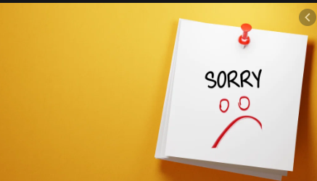

Sorry note

Slide 4


Slide 5
What is causation?
It indicates that one event is the result of the occurrence of the other event;
i.e., there is a causal relationship between the two events.
This is also referred to as cause and effect.”

Slide 6
Measures of association
A measure of association quantifies the relationship between exposure and disease among the two groups.
Positive association and Negative association.

Slide 7
Examples of outcome measurement
Risk ratio (relative risk)
Rate ratio
Odds ratio
Proportionate mortality ratio
Many more.

Slide 8
Rate /ratio/proportion
Ratio
  Just ratio of two things
Proportion
  Numerator included in denominator
Rate
  Proportion relative to time

Slide 9
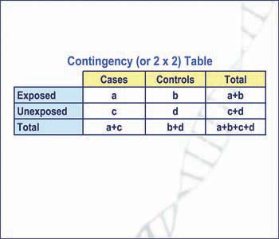
The contingency table

Slide 10
My topic
Odds ratio
Relative risk
Correlation

Slide 11
Types of study
Observational study
  Case control study
  Cohort study
Interventional study

Slide 12


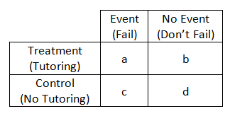
The formula-see the denominator
[Number of events]
[All outcomes i.e., all events + no events]
OR- Odds Ratio
RR - Relative Risk/Risk ratio
[Number of events]
[Number of no events]

Slide 13


Risk vs ODD
Risk
ODD

Slide 14

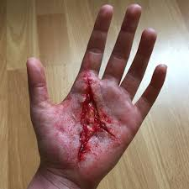
Risk vs ODD
Risk
ODD

Slide 15
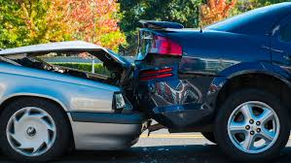
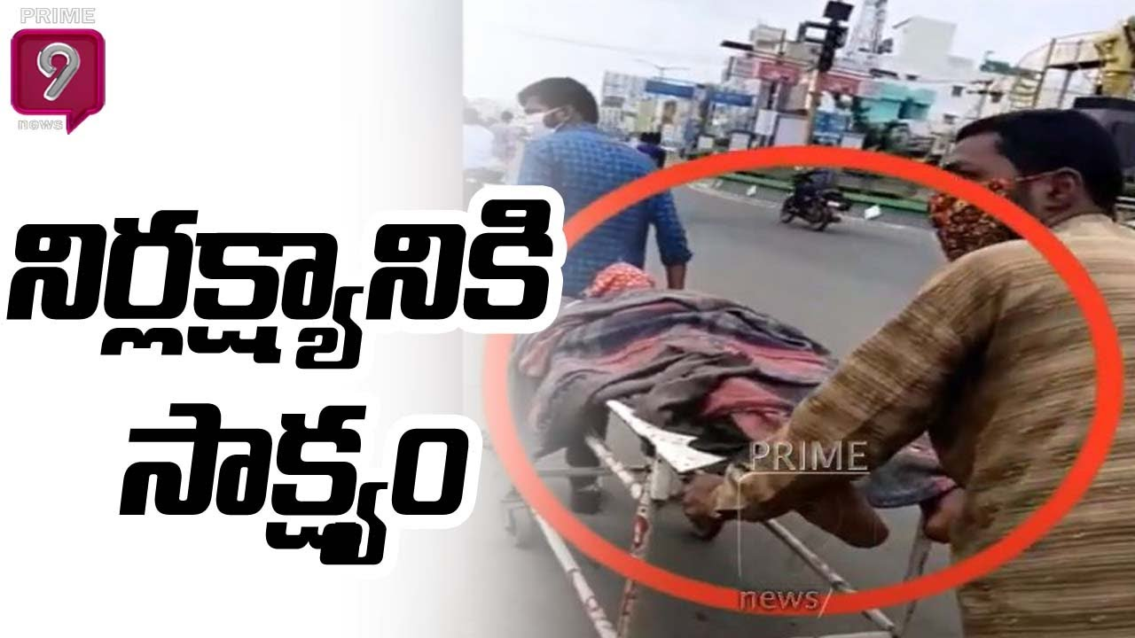
Risk vs ODD
Risk
ODD

Slide 16


Risk vs ODD
Risk
ODD

Slide 17




Invited the risk

Slide 18

Dating

Slide 19
The risk

Slide 20

The mother[monster] in law

Slide 21

The odd

Slide 22

Relative risk
When the relative causes the risk

Slide 23

The Causative factor

Slide 24


Slide 25


Mother in law vs monster in law

Slide 26

The counselor

Slide 27
ONE BAD NEWS
ONE GOOD NEWS

Slide 28
Relative risk
Incidence of outcome in exposed cohort
Incidence in unexposed cohort

Slide 29
Interpreting relative risk
If the risk ratio is 1 (or close to 1), it suggests no difference or little difference in risk (incidence in each group is the same).
  No association
A risk ratio > 1 suggests an increased risk of that outcome in the exposed group.
  Positive association, increased risk
A risk ratio < 1 suggests a reduced risk in the exposed group.
  Negative association, decreased risk

Slide 30
Fighting incidence when mother in law as exposure
Mother in law | Fighting | No Fighting | Total
Yes | 45 | 55 | 100 | 45/100 = 0.39
No | 10 | 90 | 100 | 10/100=0.1
Relative risk | 0.45/0.1 = 4.5
In this study persons who has having mother in law as relative there is 4.5 times higher the risk of fighting between couples
THE BAD NEWS

Slide 31
Fighting incidence when you follow mother in law advice
Follow Mother in law | Fighting | No Fighting
Yes | 5 | 20 | 5/25 = 20%
No | 20 | 5 | 20/25 =80%
Relative risk | 20/80 =0. 4
In this study persons who regularly following mother in law advice there is 0. 4 times the risk of fighting between couples compared to who dose not follow
THE GOOD NEWS

Slide 32
How to explain?
As percentage increase and decrease
As number of times increase and decrease

Slide 33
Relative risk 1.37 means
Risk of disease increased by 37%
RRR= [1-RR] X 100
Risk of disease increased by 1.37 times

Slide 34
Relative risk 0.8 means
Risk of disease decreased by 20%
RRR= [1-RR] X 100
Risk of disease less by 0.2 times

Slide 35
Relative risk 3.37 means
Risk of disease increased by 237%
RRR= [1-RR] X 100
Risk of disease increased by 3.37 times

Slide 36
How strong is the association
If p value is more than 0.05
If confidence interval includes 1
RR is not statically significant
No matter how is the large or small RR

Slide 37
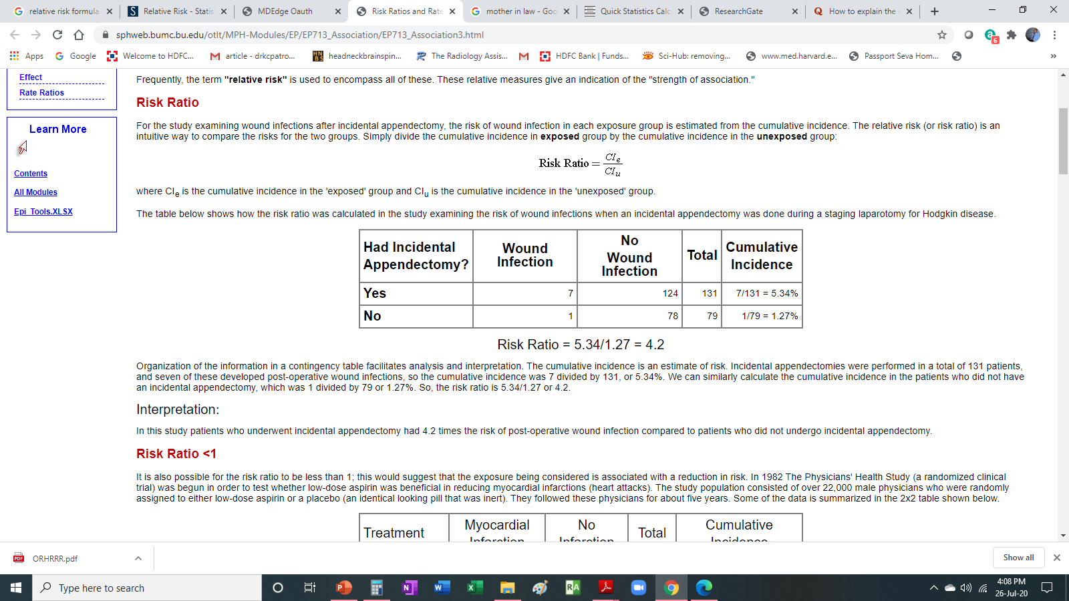
RR >1

Slide 38
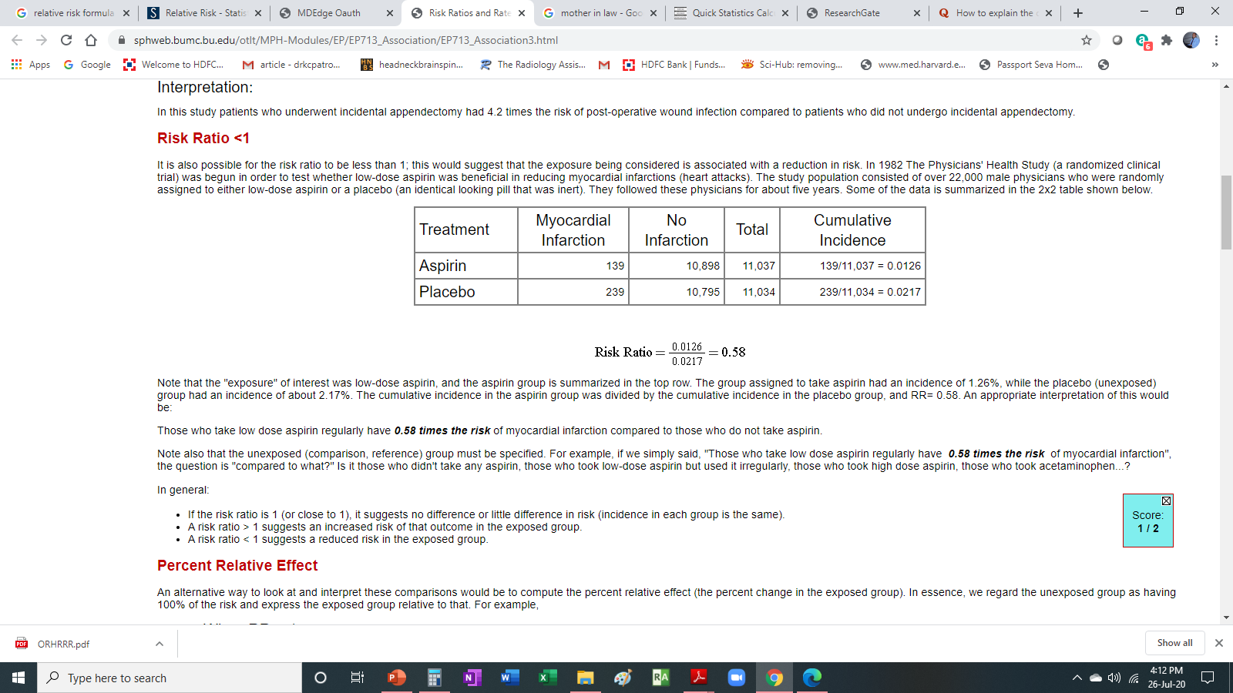
RR <1

Slide 39
Odds ratio
odds of exposure in those with disease
odds of exposure in those with out disease

Slide 40
Fighting incidence when mother in law as exposure
Mother in law | Fighting | No Fighting | Total
Yes | 45 | 55 | 100 | 45/55 = 0.82
No | 10 | 90 | 100 | 10/90=0.11
Odds ratio | 0.82/0.11 = 7.45
In this study persons who has having mother in law as relative there is 7.45 times of odd fighting between couples

Slide 41
Fighting incidence when you follow mother in law advice
Follow Mother in law | Fighting | No Fighting
Yes | 5 | 20 | 5/20 = 0.25
No | 14 | 11 | 14/11 =1.27
odd | 0.25/1.27 =0.2
In this study persons who regularly following mother in law advice there is 0. 2 times the risk of fighting between couples compared to who dose not follow

Slide 42
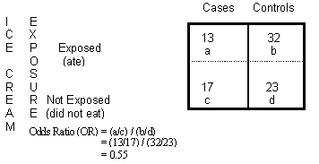
OR < 1

Slide 43
Interpreting odds ratio
If the odds ratio is 1 (or close to 1), it suggests no difference or little difference in risk
  No change in frequency of exposure
A odds ratio > 1 suggests an increased risk of that outcome in the exposed group.
  Increased change in frequency of exposure
A odds ratio < 1 suggests a reduced risk in the exposed group.
  Decreased change in frequency of exposure

Slide 44
Interpreting odds ratio
An OR of 1.2 means there is a 20% increase in the odds of an outcome with a given exposure.
An OR of 2 means there is a 100% increase in the odds of an outcome with a given exposure
A RR of 0.5 means the risk is cut in half
An odds ratio of 1.33 means that in one group the outcome is 33% more likely
A odds ratio is 1.24, the likelihood of having the outcome is 24% higher (1.24 – 1 = 0.24 i.e. 24%) than the comparison group.
If odds ratio is 2.5, then there is a 2.5 times higher likelihood of having the outcome compared to the comparison group

Slide 45
How strong is the association
If p value is more than 0.05
If confidence interval includes 1
OR is not statically significant
No matter how is the large or small OR

Slide 46
The formula-see the denominator
[Number of events]
[All outcomes i.e., all events + no events]
OR- Odds Ratio
RR - Relative Risk/Risk ratio
[Number of events]
[Number of no events]

Slide 47
See the denominator
Relative Risk
Odds Ratio
A
A+B
A = 1
B = 2
1/3 = 0.33
A = 5
B = 2
5/7 = 0.49
A
B
A = 1
B = 2
1/2 = 0.5
A = 5
B = 2
5/2 = 2.5

Slide 48
OR overestimates the risk
80/100 people who use it get cancer.
20/100 who don’t use it get cancer.
The risk of getting cancer is 4 times greater in drug users.
RR = 0.8/0.2 = 4
Note how distorted the OR becomes in this example.
OR = (80/20)/(20/80) = 16

Slide 49
Rare outcome
5/1000 get cancer with drug vs 2.5/1000 for non-users.
RR = 2.
OR = 2 as well (actually 2.005)
With rare outcomes, the RR and OR are very similar

Slide 50
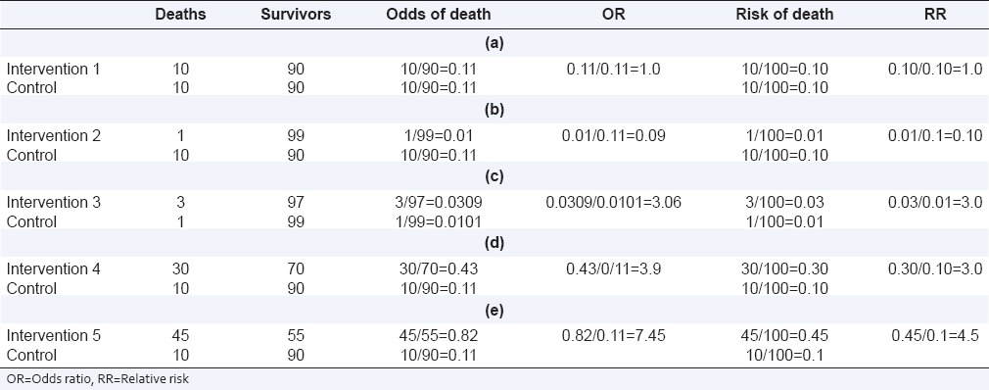

Slide 51
The difference
The basic difference is that the odds ratio is a ratio of two odds whereas the relative risk is a ratio of two probabilities.
The general rule though is that if the prevalence of the disease is <10% or so, the relative risk and the odds ratio will be approximately the same.
The rarer the disease, the closer the approximation.
RR has a more natural interpretation but cannot be calculated from a cross-sectional and case-control study

Slide 52
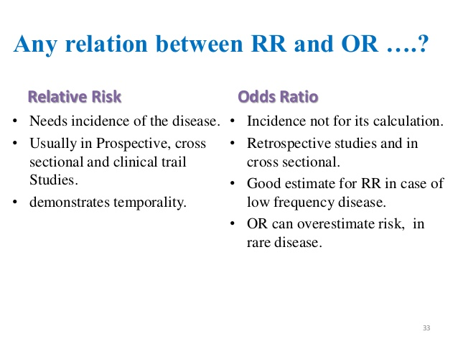
OR vs RR

Slide 53
The outcome measures
The outcome measure in cohort studies is usually a risk ratio / relative risk (RR).
The main outcome measure in case-control studies is odds ratio (OR).
Calculation of risk requires the use of “people at risk” as the denominator.
In retrospective (case-control) studies, where the total number of exposed people is not available, RR cannot be calculated and OR is used as a measure of the strength of association between exposure and outcome.
By contrast, in prospective studies (cohort studies), where the number at risk (number exposed) is available, either RR or OR can be calculated

Slide 54
Type of studies
Retrospective
  Case control
  Cohort
Prospective
  Cohort

Slide 55
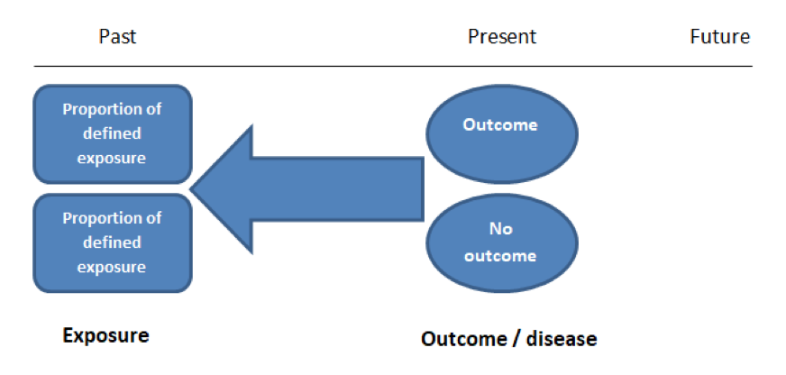
The CASE CONTROL study

Slide 56
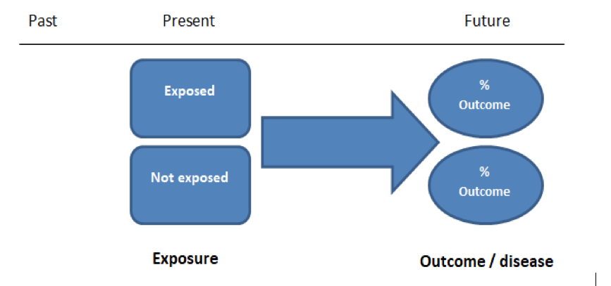
The COHORT study

Slide 57
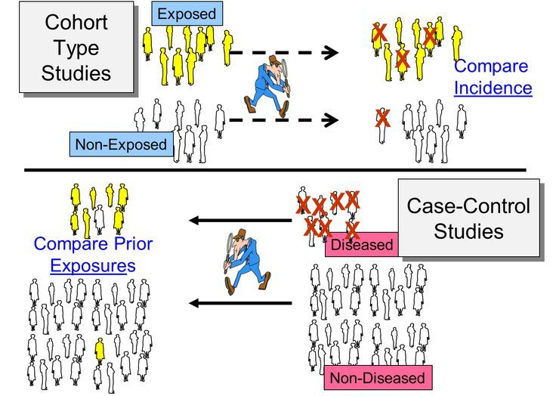

Slide 58
Case control study example
Food poisoning after eating restaurant
To find the association
You are doing retrospective study
You are doing a study where all are exposed.
Not true population
You calculate Odds ratio

Slide 59
Cohort study example
Smoking and lung cancer
To find the association
You are doing prospective study
You are doing a study where two types of population one is exposed and another is control
True population
You calculate Relative Risk

Slide 60
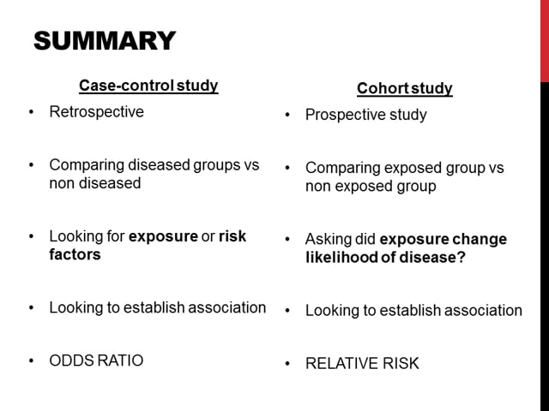
Summary

Slide 61
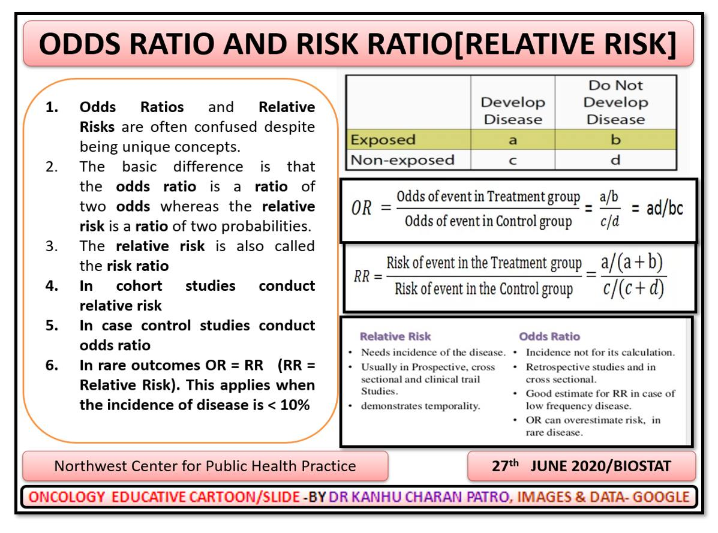

Slide 62

When you follow the mother in law as relative in excess she becomes odd

Slide 63

AOGIN
AUDIENCE

